Slide 1
RESTful web service development in .NET
Alberto Castro

Slide 2
OVERVIEW
API
REST
SOAP vs REST
HTTP Verbs and CRUD
RESTFul API with .NET Core
Hosting
Startup class
API controller
Web Application
REST API
Data Access Layer
DB

Slide 3
API
What is an API (Application programming interface)
Set of functions, protocols, data structures, classes…
Contracts for building interoperable applications
Information hiding
Private, partner, public
Interface stability for public API
WebApp
API
Middle layer
API
DAL

Slide 4
REST
REST: Representational State Transfer
Architectural style for networked applications
Alternative to RPC, SOAP
Support for different data formats (JSON)
Use of standard HTTP protocol
No proxy required
Based on the representation of resources (URI)
Support for CRUD operations using HTTP verbs (create, read, update, delete)
REST
XML
JSON
…
HTTP GET
HTTP
POST
HTTP
PUT
HTTP
DEL
Resource URI
Application
SOAP
SOAP (XML)
SMTP
HTTP
POST
MQ
Endpoint URI
Application

Slide 5
SOAP vs REST
SOAP request message
REST request URI
<soap:Envelope xmlns:soap="http://schemas.xmlsoap.org/soap/envelope/"> <soap:Body>
<getProductDetails xmlns="http://magazzino.example.com/ws"> <productId>827635</productId> </getProductDetails> </soap:Body> </soap:Envelope>
http://hostname/api/getProductDetails?productId=827635
SOAP Response message
REST response body
<soap:Envelope xmlns:soap="http://schemas.xmlsoap.org/soap/envelope/"> <soap:Body> <getProductDetailsResponse xmlns="http://magazzino.example.com/ws"> <getProductDetailsResult> <productName>Toptimate, set da 3 pezzi</productName> <productId>827635</productId> <description>Set di valigie; 3 pezzi; poliestere.</description> <price>96.50</price> <inStock>true</inStock> </getProductDetailsResult> </getProductDetailsResponse> </soap:Body> </soap:Envelope>
{
“productName”: “Toptimate, set da 3 pezzi”,
“productId”: 827635,
“description”: “Set di valigie; 3 pezzi; poliestere.”,
“price”: 96.50,
“inStock”: true
}

Slide 6
HTTP Verbs and CRUD
HTTP methods (verbs): actions on a specified resource
GET: requests a representation of the specified resource
POST: requests a modification of the specified resource using a provided entity (body)
PUT: requests the store of a provided entity (body) under the supplied resource
DELETE: delete the specified resource
PUT
CREATE
GET
READ
POST
UPDATE
DELETE
DELETE

Slide 7
.NET Core RESTFul API
.NET core Console app, Windows Service, Docker container
Required packages:
Hosting: Microsoft.AspNetCore.Hosting
WebServer: Microsoft.AspNetCore.Server.Kestrel
WebAPI: Microsoft.AspNetCore.Mvc
static void Main(string[] args)
{
var host = new WebHostBuilder()
.UseKestrel() //Integrated WebServer
.UseStartup<Startup>() //Services and request pipeline configuration
.Build();
host.Run();
}
https://docs.microsoft.com/en-us/aspnet/core/fundamentals/hosting?tabs=aspnetcore2x

Slide 8
.NET Core RESTFul API: Startup class
Must include a Configure method
Optional ConfigureServices method
public class Startup
{
/// <summary>
/// Method called before the "Configure" method by the web host.
/// Used to add services to the services container that will be available to the application via dependency injection.
/// </summary>
/// <param name="services"></param>
public void ConfigureServices(IServiceCollection services)
{
//Adding the ASP.NET's Mvc service
services.AddMvc();
}
/// <summary>
/// Method used to specify how the application will respond to HTTP requests.
/// </summary>
/// <param name="app">Application builder.</param>
public void Configure(IApplicationBuilder app)
{
//Each "Use" extension method adds a middleware component to the request pipeline.
app.UseMvcWithDefaultRoute(); //Adding the ASP.NET’s routing middleware
}
}
https://docs.microsoft.com/en-us/aspnet/core/fundamentals/startup

Slide 9
.NET Core RESTFul API: ApiController
A controller class is used to define and group a set of actions.
An action is a method on a controller which handles requests.
Attribute routing
[Route("api")] //base URI prefix
public class StudentsController : Controller
{
[HttpGet("students")]
public async Task<IActionResult> GetStudents() { }
[HttpPut("students")]
public async Task<IActionResult> CreateStudent([FromBody]Student student) { }
[HttpPost("students")]
public async Task<IActionResult> UpdateStudent([FromBody]Student student) { }
[HttpDelete("students")]
public async Task<IActionResult> DeleteStudent([FromQuery]int id) { }
}
https://docs.microsoft.com/en-us/aspnet/core/mvc/controllers/routing

Slide 10
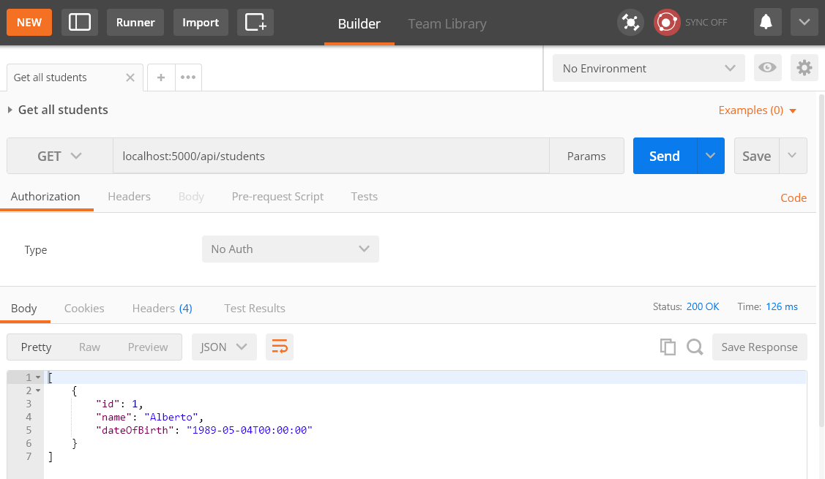
POSTMAN
Tool for building API requests for testing, documentation and sharing.
https://www.getpostman.com/

